Slide 1


Data Science Assignment 3
Isabel de Waal- 20805055
Difedile Rasenyalo- 28294882
Notes:
Greetings, everyone. My name is Difedile Rasenyalo, and I'm joined by Isabel. Together, we'll guide you through our presentation

Slide 2
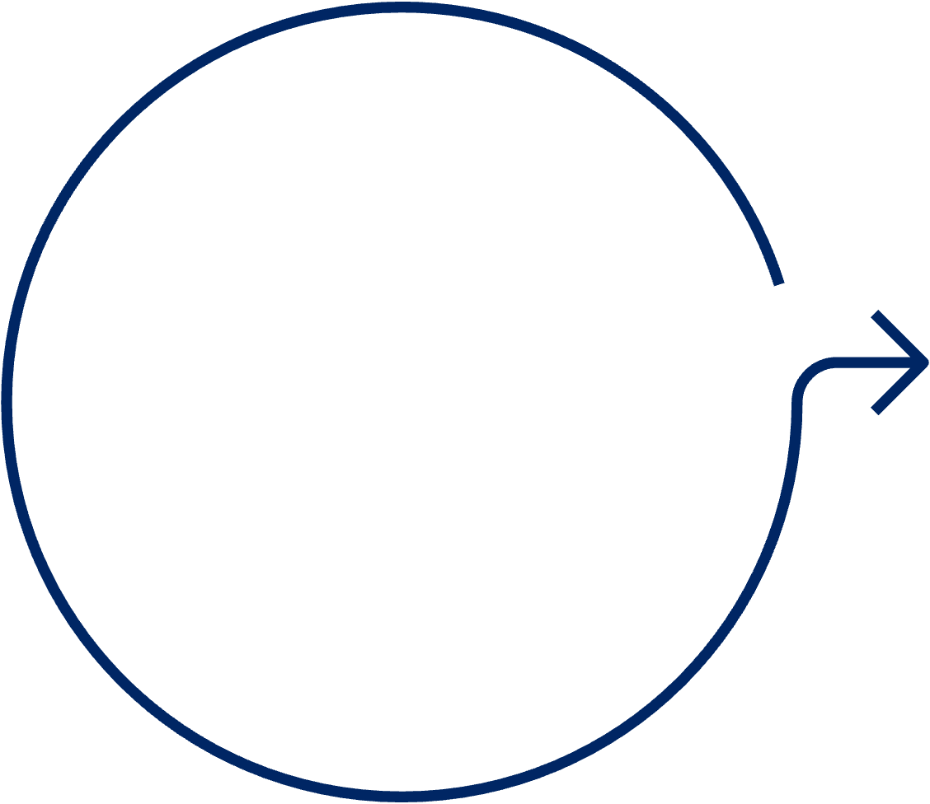






Content
1
2
3
4
5
Introduction
Methodology
Modelling
Results & Discussion
Conclusion
Notes:
We're excited to walk you through our presentation, covering the introduction, methodology, modelling, results & discussion and the conclusion.

Slide 3


1. Introduction
Background
Missing values are a common occurrence in datasets. It's not unusual to encounter datasets where a significant portion, sometimes up to half, of the entries are missing. Such datasets pose challenges for data analysis methods that require complete data. To address this issue, imputation methods are often employed to fill in the missing values. This paper delves into the influence of various imputation methods on classifier performance when applied to imputed data. Specifically, it investigates the effects of mean imputation and K-nearest neighbour imputation. The evaluation employs two widely used classifiers, K-nearest-neighbour, and decision tree classifiers, to gauge the effectiveness of these imputation techniques.
Objectives
Task A: The objective is to evaluate the effectiveness of a baseline imputation compared to Naïve Bayes imputation on classification model performance. Additionally, the study explores the influence of the proportion of missing values on the effectiveness of the imputation method.
Task B: Building upon Task A, this objective involves using the K Nearest Neighbours classifier to address missing numerical values. Furthermore, this approach's effectiveness will be compared against a baseline numerical value imputation method using two distinct machine learning models.
Notes:
Missing values are a common occurrence in datasets. It's not unusual to encounter datasets where a significant portion, sometimes up to half, of the entries are missing. Such datasets pose challenges for data analysis methods that require complete data. To address this issue, imputation methods are often employed to fill in the missing values. This paper delves into the influence of various imputation methods on classifier performance when applied to imputed data. Specifically, it investigates the effects of mean imputation and K-nearest neighbour classifier imputation. The evaluation employs two widely used classifiers, K-nearest-neighbour, and decision tree classifiers, to gauge the effectiveness of these imputation techniques.
The objective is to evaluate the effectiveness of a baseline imputation compared to Naïve Bayes imputation on classification model performance. Additionally, the study explores the influence of the proportion of missing values on the effectiveness of the imputation method.
Building upon Task A, this objective involves using the K Nearest Neighbours classifier to address missing numerical values. Furthermore, this approach's effectiveness will be compared against a baseline numerical value imputation method using two distinct machine learning models.

Slide 4




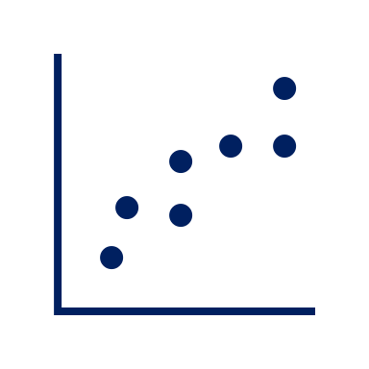



2.Methodology
1
Selecting Dataset
A dataset with documented research on handling missing feature values was selected. The Adult dataset was selected in the study done by A. Farhangfara, L. Kurganb, and J. Dyc.
4
Imputation Approach
The K-NN and mean imputation technique was used to address this issue, of missing values.
2
5
Model Comparison
The results from the K-NN and decision tree classifiers are evaluated using performance metrices including accuracy, precision, recall, and F1-score, will be evaluated and compared.
Data Exploration
The Adult dataset was explored to gain an understanding of its structure, variables, and content.
3
Inducing Missing Values
Missing data were randomly introduced into each of the datasets using the Missing Completely at Random (MCAR) mechanism. The missing values were added to all attributes across all datasets at three different rates: 10%, 40%, and 70%.
6
Visualization
Bar graphs were crafted to vividly illustrate the performance disparity between the two models when trained with data imputed using distinct methods.
Notes:
In this study, we leveraged Python as the primary tools for imputation, modelling, and evaluation. The methodology involved several key steps:
Selecting Dataset
A dataset with documented research on handling missing feature values was selected. The Adult dataset was selected in the study done by A. Farhangfara, L. Kurganb, and J. Dyc
Data Exploration
The adult dataset was explored to gain an understanding of its structure, variables, and content. Upon review it was observed that they was a skewed distribution of the target feature.
Inducing Missing Values
Missing data were randomly introduced into each of the datasets using the Missing Completely at Random (MCAR) mechanism. The missing values were added to all attributes across all datasets at three different rates: 10%, 40%, and 70%.
Imputation Approach
The K-NN and mean imputation technique was used to address this issue, of missing values.
Model Comparison
The results from the K-NN and decision tree classifiers are evaluated using performance metrices including accuracy, precision, recall, and F1-score, will be evaluated and compared.
Visualization
Bar graphs were crafted to vividly illustrate the performance disparity between the two models when trained with data imputed using distinct methods

Slide 5
3.Modelling- Discission tree Classification

Slide 6
Modelling: K- Nearest Neighbour Classification

Slide 7
Conclusion

Slide 8
Decision Tree
Low
0- 10%
Deletion of instance
Missing data proportion is high
Strong dependencies between variables [3].
Naïve Bayes Imputation
Degree of missing values
Medium
Categorical features
10%- 40%
Imputation
Missing data proportion is low
Relationships between variables are weak [4]
Mode Imputation
High
40%- 70%
Feature deletion
Dataset with missing values
Low
0- 10%
Deletion of instance
Missing data proportion is low.
If the data distribution is approximately normal [5].
K-NN Imputation
Degree of missing values
Medium
Numeric Features
10%- 40%
Imputation
Missing data proportion is significant
Strong correlations between variables [3]
Mean Imputation
High
40%- 70%
Feature deletion
P. Alison, “Missinf Data Techniques for structrural Eqaution Modelling,” Journal of abnormal psychology , 2003.
P. S. A. O. J. Q. Son Nguyen, “Effects of resampling techniques on imblanced data classification,” 2021.
P. C. E. E.-F. John Graham, “Methods of hamdling missing values,” Research Methods in Psychology , vol. 2, 2003.

Slide 9
References
P. Alison, “Missinf Data Techniques for structrural Eqaution Modelling,” Journal of abnormal psychology , 2003.
P. S. A. O. J. Q. Son Nguyen, “Effects of resampling techniques on imblanced data classification,” 2021.
P. C. E. E.-F. John Graham, “Methods of hamdling missing values,” Research Methods in Psychology , vol. 2, 2003.

Slide 10

Thank You

